Slide 1
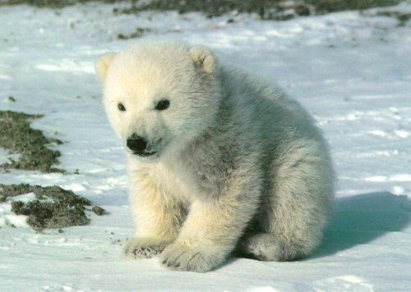
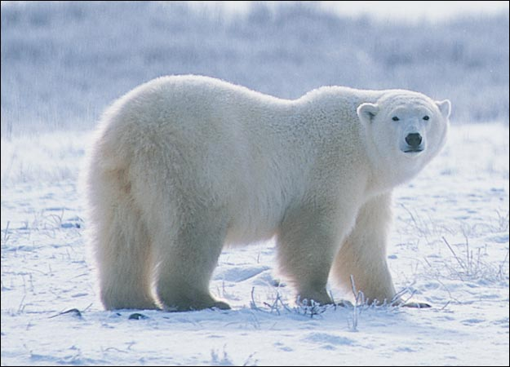
Polar bears
Created by: Alma, Rajath, and Nikhil

Slide 2
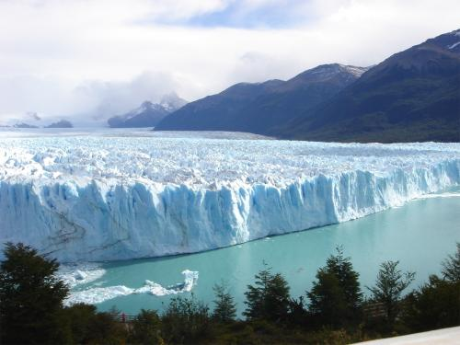
Habitat
The polar bears habitat encompass the entire arctic region.
Its preferred habitat is the sea ice on the continental shelf.
The polar bear prefer where the sea meets the ice, because that is where the polar bear gets it’s fish and seals.
When summer comes the ice starts breaking apart so they are forced to move back on land for the next few months.

Slide 3
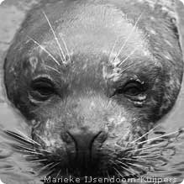
Prey
Polar bears need sea ice to launch hunting expeditions for ringed seals, fish, and crab their primary prey.
The polar bear uses a method of hunting called still-hunting.
Still-hunting is where the polar bear uses it’s expert sense of smell to find the seal under the sea ice and dig a hole to and get the seal.
The Polar Bear kills the seal by biting the skull and

Slide 4
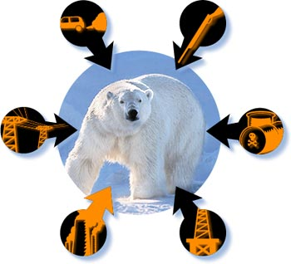
Threats
The polar bears habitat , which is mainly in the arctic circle, is melting at a swift pace.
Toxic chemicals from the south fall mainly to the arctic which are disturbing the polar bears way of life.
Also the new oil exploration is leaving oil and other toxic wastes in their environment.
Another great threat is hunting polar bears for game.

Slide 5
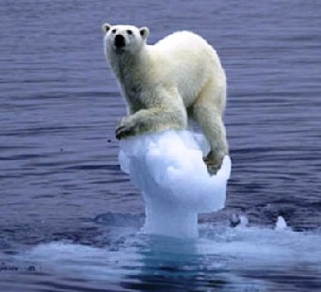
Climate change
The main danger made by global warming is not enough nutrition and starvation because of habitat loss.
The subpopulation size of polar bears in the Hudson bay of new York has decreased by 22% from 1987 to 2004.
Polar bears must travel greater distances to get food since the traditional feeding area is melting.
They also have reduced accses to their dens in the winter because of the melting ice and snow.

Slide 6
Here are some pictures

Slide 7
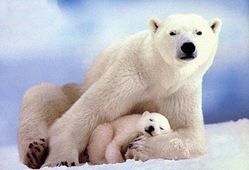
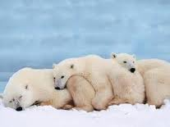
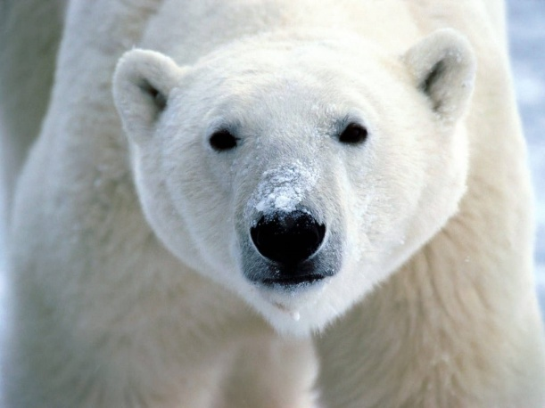
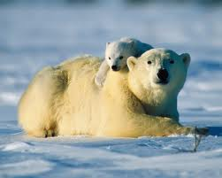
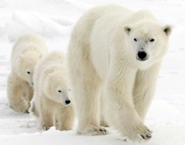
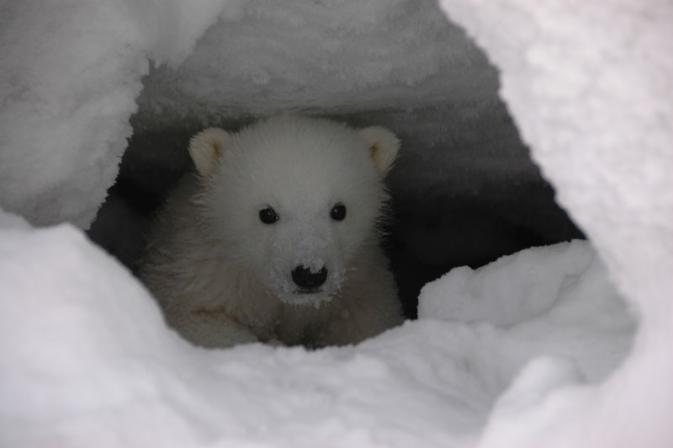
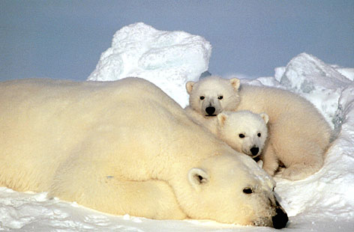
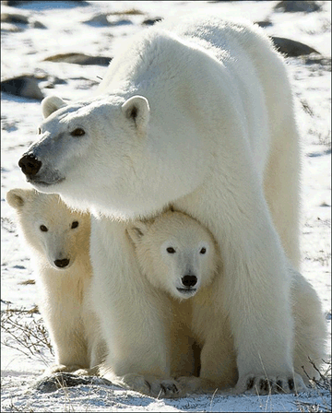
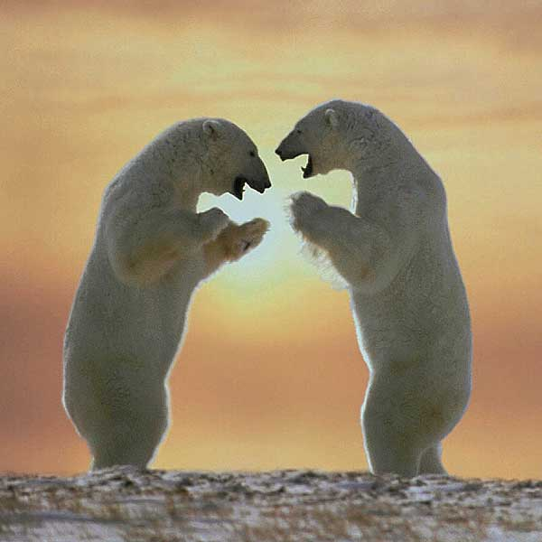
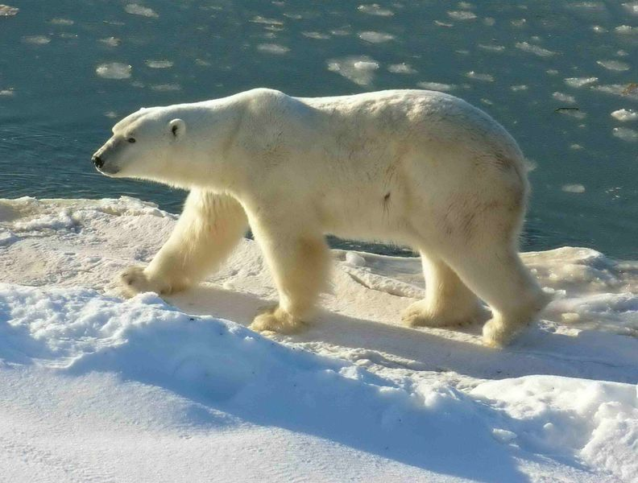
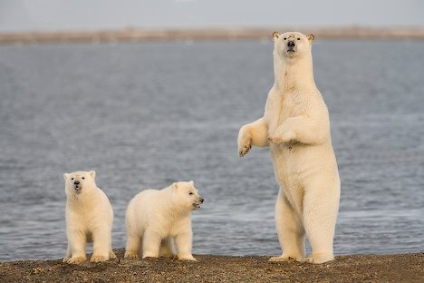
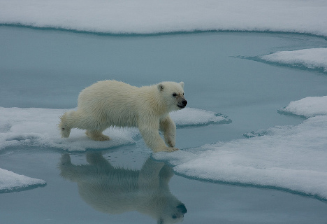
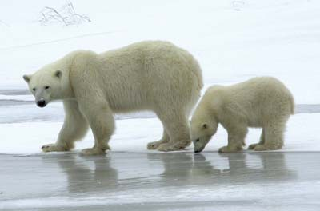
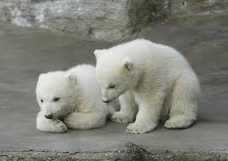
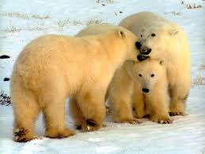

Slide 8
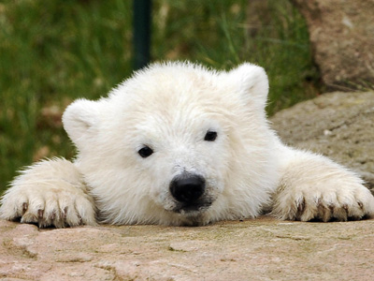
Help save my home

Slide 9
Thanks for watching our slide show.

