Slide 1
By DAVIN, ANSHUMAN and HARSHAD
HOW CLIMATE CHANGE AFFECTS PEOPLE!
Notes:
anshuman

Slide 2
Climates Around the World
There are many different types of climates around the world and different temperatures that they vary in. There are cold climates, hot climates and some just perfect climates. These climates all affect humans, some in the most simplest ways and some in the complicated ways.
Notes:
davin

Slide 3
Global Warming
Global Warming is occuring because of man-made pollutants which traps the suns heat in earths atmosphere, which slowly forces the temperature to rise. Although the rise in temperature is gradual, the impact of it on earth is very visible and it is scary. We must take action now to save our special planet. We must save earth while we can.
Notes:
harshad

Slide 4
What will happen to us
We are also going to become extinct in around a few thousand years, but we will suffer a lot before that. There will be war, and fighting for food amongst us people because all the animals will have already become extinct.
Notes:
davin

Slide 5
Beginning of the end.
People will install lots of Air-Conditioners because some don't want the fans and like it to be luxurious so the outside air will already become become hotter than it already is and to add to that people will want to travel in AC vehicles to not experience the heat therefore leading to the global warming. As for the underprivileged, they will die so soon because they don't have the neccesary means to survive the effects of global warming. Little by little, us humans will become extinct.
Notes:
harshad

Slide 6
In the END
Finally we are all going to die. After thousands of years of suffering, we will start to see mega high death rates and soon all forms of life will disappear.
Notes:
davin

Slide 7
Following is a few pictures that will hopefully give you a glimpse into the future
Notes:
anshuman

Slide 8
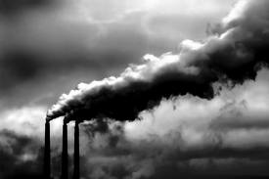

Slide 9
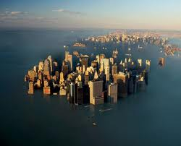
Is this what you want for your children and yourself?

Slide 10
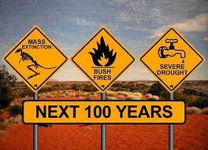
This is probably what is going to happen to earth.

Slide 11
Did you see that - that is what may happen - if we do not take action now against global warming.

Slide 12
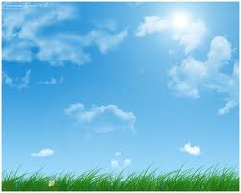
we are being affected by global warming by having extreme temperatures, massive droughts and only one season all around the world, SUMMER.

Slide 13
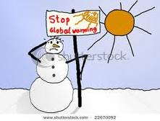
At the rate we are going, there will be no more snow for children to play with and for our sports of skiing and many others.

Slide 14
THANK YOU FOR WATCHING OUR PRESENTATION
Notes:
ANSHUMAN

