Slide 1
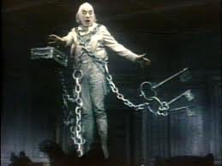
In Life, I was known as Jacob Marley. I worked alongside my friend and partner, Ebenezer Scrooge. I lived in London, but died on Christmas Eve. When I died, I was immediately clapped in chains, padlocks, and wrought iron cashboxes. It was painful. It is a great burden for which I am doomed to carry on my back for all eternity. They represent the folly of my ways. In life, I never questioned my ways. And pushed away any doubt. If I was still alive., I most definitely would have continued in this way. If I could change one thing, I would have changed my entire attitude towards charity and Christmas.
I feel great pain surveying my friend Scrooge decide his fate to be the same as mine. He was an excellent friend to me. Often I’d heard that ‘I was the only one to which he’d shown any respect. We thought and acted alike, and we had the same interests. 2 peas in a pod was an understatement.

