Slide 1
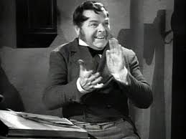
VOX POP OF BOB CRATCHIT
My name is Bob Cratchit. I work as a clerk in Ebenezer Scrooge’s counting-house. I do not really get a lot of money while working for Mr. Scrooge, but I still need money for my family. Most importantly, I am working to heal Tiny Tim, my youngest son. I have a large family to take care of, and we are not very rich. So, whatever salary I get from Mr. Scrooge, I am still happy with it as I am very optimistic. I do not think Mr.Scrooge is a good boss, because he is really mean to me and does not think about my situation. My family does not like Mr. Scrooge and he calls him an ‘ogre’. I really like Christmas as ;it is a time of the year when the rich give to the poor and it is a time of sharing and caring. On Christmas Day, I asked for a day off from Mr. Scrooge and he very reluctantly said yes.
REPORT BY AGNEESH DASGUPTA-INDUS GAZETTE

